Slide 1
TOPIC 2
INTRODUCTION TO MICROCONTROLLER
E4160 – Microprocessor & Microcontroller System

Slide 2
Intended Learning outcomes
1
At the end of this topic, students should be able to:
  eplain briefly the microcontroller-based system using block diagram.
  list the types of microcontroller and examples of embedded microcontroller/ embedded system
  describe the features and internal structure of a microcontroller (PIC16F877A).
  describe how an instruction is executed.

Slide 3
Introduction
2
What is a microcontroller?
A microcontroller (sometimes abbreviated µC, uC or MCU) is a small computer on a single integrated circuit containing a processor core, memory, and programmable input/output peripherals. It can only perform simple task. A microcontroller is often described as a ‘computer-on-a-chip’.

Slide 4
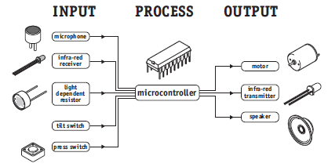
Microcontrollers are purchased ‘blank’ and then programmed with a specific control program.
Once programmed the microcontroller is build into a product to make the product more intelligent and easier to use.
A designer will use a Microcontroller to:
- Gather input from various sensors
- Process this input into a set of actions
- Use the output
mechanisms on
the microcontroller
to do something
useful.
3

Slide 5
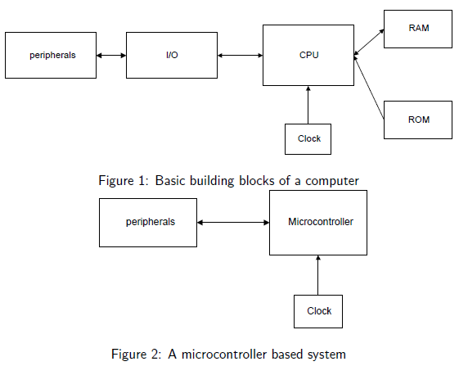
The Different between microcomputer system and microcontroller based system
4

Slide 6
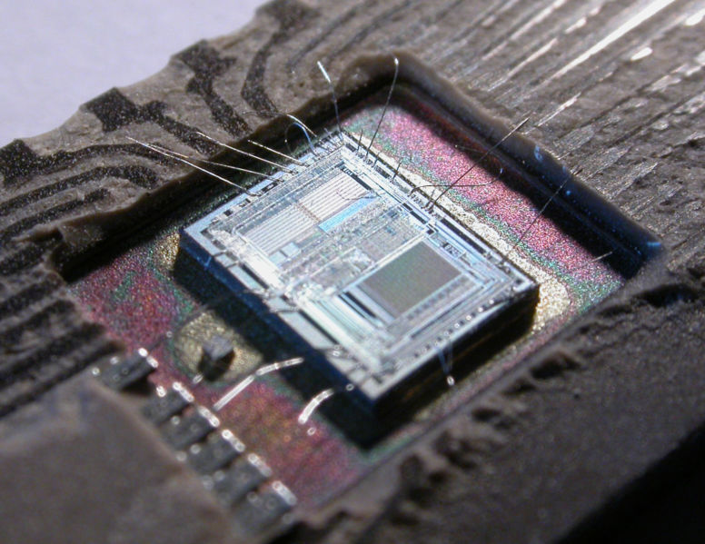
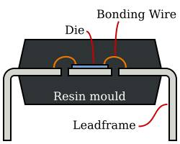
Real inside microcontroller
5

Slide 7
Embedded System
6
Microcontrollers are sometimes called embedded microcontrollers, which just means that they are part of an embedded system -- that is, one part of a larger device or system.
The majority of microcontrollers in use today are embedded in other machinery, such as automobiles, telephones, appliances, and peripherals for computer systems. These are called embedded system.

Slide 8
…cont’d
7
Typical input and output devices include switches, relay, solenoids, LEDs, small or custom LCD displays, radio frequency devices, and sensors for data such as temperature, humidity, light level etc.
Embedded systems usually have no keyboard, screen, disks, printers, or other recognizable I/O devices of a personal computer, and may lack human interaction devices of any kind.

Slide 9
Examples of Embedded System
8
Consumer Electronic : DVD player, hi-fi, TV, air-conditioner, washing machine etc.
Medical Monitoring Devices : ECG (electrocardiogram), blood pump, blood pressure meter, etc.
Security System : Alarm, remote sueveilance, smart card + reader etc.
Closed Loop Process Control : Motor speed control, robot, SCADA (supervisory control & acquisition) etc.
Personal Computing : Keyboard, printer, USB hub, SCSI HD, energy management etc.
Automotive : Ignition control, A/C, Automatic transmission, anti-lock brake system (ABS), active suspension, etc
Military : Missile, torpedo, ejection seat, etc
Communications : Handphone, modem, radio, radar, satelite etc.

Slide 10
Types of Microcontroller
9
Parallax Propeller
Freescale 68HC11 (8-bit)
Intel 8051
Silicon Laboratories Pipelined 8051 Microcontrollers
ARM processors (from many vendors) using ARM7 or Cortex-M3 cores are generally microcontrollers
STMicroelectronics STM8 (8-bit), ST10 (16-bit) and STM32 (32-bit)
Atmel AVR (8-bit), AVR32 (32-bit), and AT91SAM (32-bit)
Freescale ColdFire (32-bit) and S08 (8-bit)
Hitachi H8, Hitachi SuperH (32-bit)
Hyperstone E1/E2 (32-bit, First full integration of RISC and DSP on one processor core [1996])
Infineon Microcontroller: 8, 16, 32 Bit microcontrollers for automotive and industrial applications.

Slide 11
…cont’d
10
MIPS (32-bit PIC32)
NEC V850 (32-bit)
Microchip PIC (8-bit PIC16, PIC18, 16-bit dsPIC33/PIC24)
PowerPC ISE
PSoC (Programmable System-on-Chip)
Rabbit 2000 (8-bit)
Texas Instruments Microcontroller MSP 430 (16-bit), C2000 (32-bit), and Stellaris (32-bit)
Toshiba TLCS-870 (8-bit/16-bit)
Zilog eZ8 (16-bit), eZ80 (8-bit)
etc

Slide 12
Microchip PIC
11
PIC is a family of Harvard architecture microcontroller made by Microchip Technology. The name PIC initially referred to "Peripheral Interface Controller“ . PIC microcontrollers were the first RISC microcontroller.
PICs are popular with both industrial developers and hobbyists alike due to their low cost, wide availability, large user base, extensive collection of application notes, availability of low cost or free development tools, and serial programming (and re-programming with flash memory) capability.

Slide 13
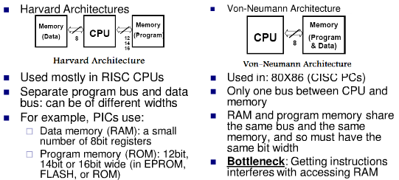
Two Different Architectures
12

Slide 14
PIC Microcontroller product family
13
8-bit microcontrollers
  PIC10
  PIC12
  PIC14
  PIC16
  PIC17
  PIC18
16-bit microcontrollers
  PIC24F
  PIC24H
32-bit microcontrollers
  PIC32
16-bit digital signal controllers
  dsPIC30
  dsPIC33F

Slide 15
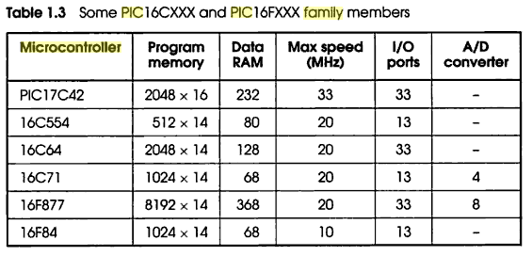
PIC Microcontroller product family
14
The F in a name generally indicates the PICmicro uses flash memory and can be erased electronically.
The C generally means it can only be erased by exposing the die to ultraviolet light (which is only possible if a windowed package style is used). An exception to this rule is the PIC16C84 which uses EEPROM and is therefore electrically erasable.
1 :

Slide 16
Why use PIC16F877?
15
Why PIC16F877A is very popular?
This is because PIC16F877A is very cheap. Apart from that it is also very easy to be assembled. Additional components that you need to make this IC work is just a 5V power supply adapter, a 20MHz crystal oscillator and 2 units of 22pF capacitors.
What is the advantages of PIC16F877A?
This IC can be reprogrammed and erased up to 10,000 times. Therefore it is very good for new product development phase.
What is the disadvantages of PIC16F877A?
This IC has no internal oscillator so you will need an external crystal of other clock source.

Slide 17
Features of PIC16F877
Key Features | PIC16F877
MAX Operating Frequency | 20MHz
FLASH Program Memory (14-bit words) | 8K
Data Memory (bytes) | 368
EEPROM Data Memory (bytes) | 256
I/O Ports | RA0-5 (6) RB0-7 (8) RC0-7 (8) RD0-7 (8) RE0-2 (3)
Timers | 3
CCP | 2
Serial Communications | MSSP, USART
Parallel Communications | PSP
10-bit Analog-to-Digital Module | 8 Channels
Instruction Set | 35 Instructions
Pins (DIP) | 40 Pins
16
8

Slide 18
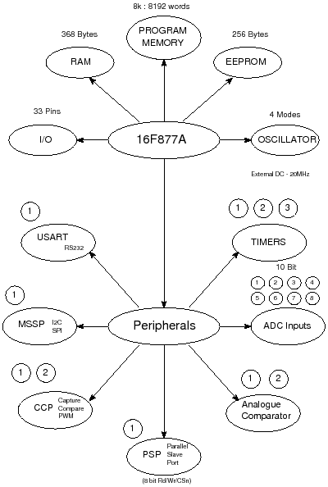
Bubble diagram of PIC16F877
17
As you can see the PIC16F877A is rich in peripherals so you can use it for many different projects.

Slide 19
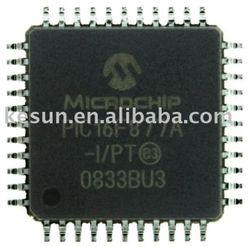
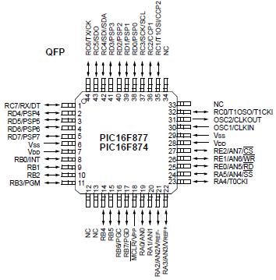
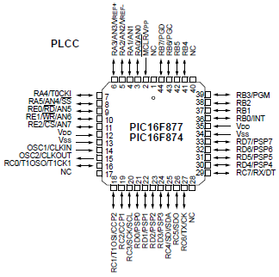
Pin Diagram of PIC16F877
18
Quad Flat Package (QFP)
Plastic Leaded Chip Carrier Package (PLCC)

Slide 20
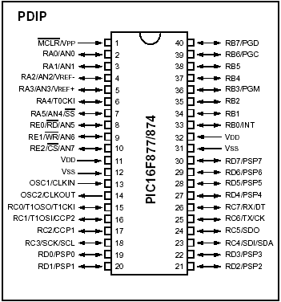
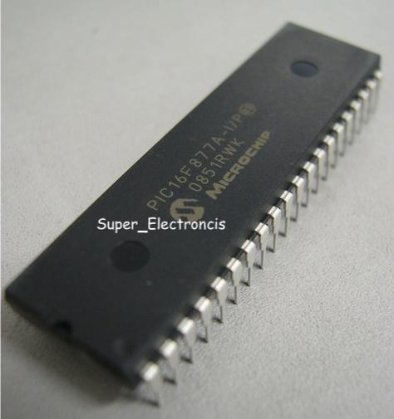
Pin Diagram of PIC16F877
19
Plastic dual in-line package (DIP)

Slide 21
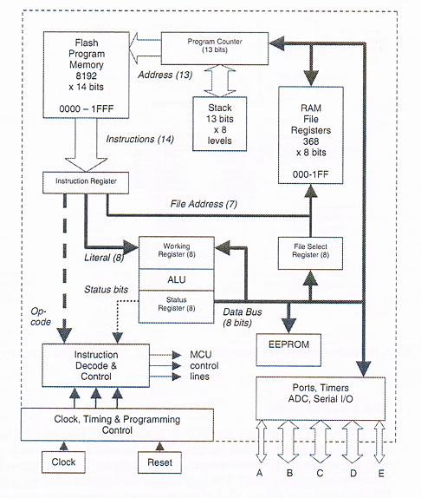
PIC16F877
Architecture
20

Slide 22
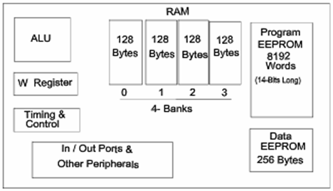
PIC16F877
Internal Block Diagram
21
The basic architecture of PIC16F877 consists of Program memory, file registers and RAM, ALU and CPU registers.
PIC16F877 Internal Block Diagram

Slide 23
Memory of the PIC16F877
22
divided into 3 types of memories:
  Program Memory – A memory that contains the program (which we had written), after we've burned it. As a reminder, Program Counter executes commands stored in the program memory, one after the other.
  Data Memory – This is RAM memory type, which contains a special registers like SFR (Special Function Register) and GPR (General Purpose Register). The variables that we store in the Data Memory during the program are deleted after we turn of the micro. These two memories have separated data buses, which makes the access to each one of them very easy.
  Data EEPROM (Electrically Erasable Programmable Read-Only Memory) – A memory that allows storing the variables as a result of burning the written program.

Slide 24
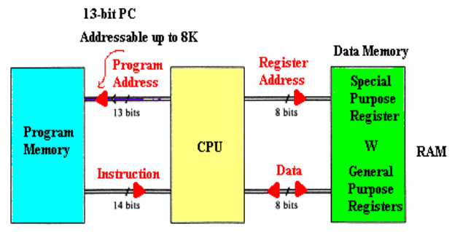
…cont’d
23
Each one of them has a different role. Program Memory and Data Memory two memories that are needed to build a program, and Data EEPROM is used to save data after the microcontroller is turn off.

Slide 25
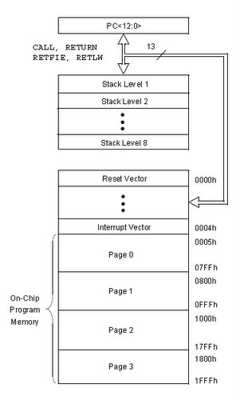
PIC16F877A Program Memory
24
Is Flash Memory
Used for storing compiled code (user’s program)
Program Memory capacity is 8K x 14 bit → Each location is 14 bits long
→ Every instruction is coded as a 14 bit word
PC can address up to 8K addresses
Addresses H’000’ and H’004’ are treated in a special way

Slide 26
PIC16F877A Data Memory (RAM)
25
Memory storage for variables
Data Memory is also known as Register File and consists of two components.
  General purpose register file (same as RAM).
  Special purpose register file (similar to SFR in 8051).
Addresses range from 0 to 511 and partitioned into 4 banks → each bank extends up to 7Fh (128 bytes).
The user can only access a RAM byte in a set of 4 banks and only one bank at a time. The default bank is BANK0.
To access a register that is located in another bank, one should access it inside the program. There are special registers which can be accessed from any bank, such as STATUS register.

Slide 27
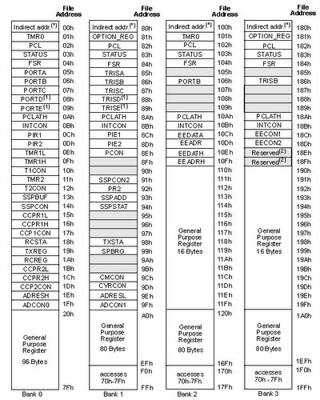
PIC16F877A register file map
26

Slide 28
PIC16F877A Registers
27
Some CPU Registers:
    W
    PC
    FSR
    IDF
    PCL
    PCLATH
    STATUS

Slide 29

W Register
28
W, the working register, is used by many instructions as the source of an operand. This is similar to accumulator in 8051.
It may also serve as the destination for the result of the instruction execution. It is an 8-bit register.
W, working register

Slide 30
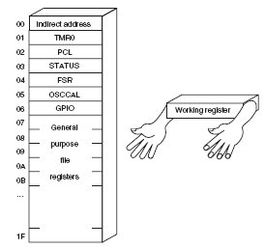

Slide 31
Program Counter
29
Program Counter (PC) is 13 bit and capable of addressing an 8K word x 14 bit program memory space.
PC keeps track of the program execution by holding the address of the current instruction. It is automatically incremented to the next instruction during the current instruction execution.
Program Counter Stack
an independent 8-level stack is used for the program counter. As the PC is 13-bit, the stack is organized as 8x13bit registers. When an interrupt occurs, the PC is pushed onto the stack. When the interrupt is being served, other interrupts remain disabled. Hence, other 7 registers of the stack can be used for subroutine calls within an interrupt service routine or within the mainline program.

Slide 32
FSR Register
(File Selection Register, address = 04H, 84H)
is an 8-bit register used as data memory address pointer. This is used in indirect addressing mode.
INDF Register
(INDirect through FSR, address = 00H, 80H)
INDF is not a physical register. Accessing INDF is actually access the location pointed to by FSR in indirect addressing mode.
30

Slide 33
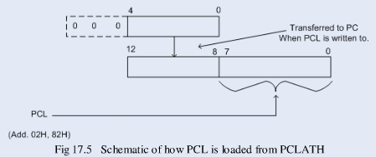
PCL Register
(Program Counter Low Byte, address =02H, 82H)
PCL is actually the lower 8-bits of the 13-bit Program Counter. This is a both readable and writable register.
PCLATH Register
(Program Counter LATcH, address = 0AH, 8AH)
PCLATH is a 8-bit register which can be used to decide the upper 5-bits of the PC. PCLATH is not the upper 5bits of the PC. PCLATH can be read from or written to without affecting the PC. The upper 3 bits of PCLATH remain zero and they serve no purpose. When PCL is written to, the lower 5bits of PCLATH are automatically loaded to the upper 5bits of the PC, as shown below:
31

Slide 34
32
In order to start programming and build automated system, there is no need to study all the registers of the memory map, but only a few most important ones:
  STATUS register – changes/moves from/between the banks.
  PORT registers – assigns logic values (“0”/”1”) to the ports
  TRIS registers – data direction register (input/output)

Slide 35

STATUS Register
33
Is an 8-bit register that stores the status of the processor.
In most cases, this register is used to switch between the banks (Register Bank Select), but also has other capabilities.
    IRP - Register Bank Select bit.
    RP1:RP0: - Register Bank Select bits.
    TO: Time-out bit
    PD: Power-down bit
    Z: Zero bit
    DC: Digit carry/borrow bit
    C: Carry/borrow bit
Used in conjunction with PIC’s sleep mode

Slide 36
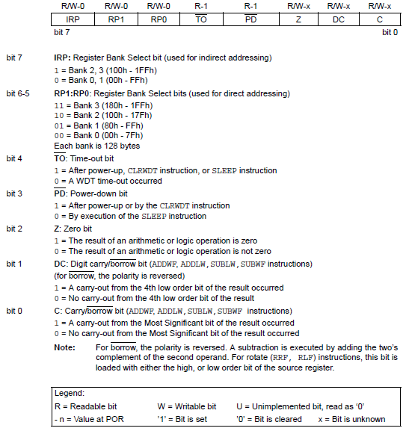
STATUS Register
34

Slide 37
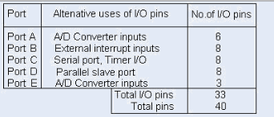
PIC16F877 Peripheral features
35
1. I/O Ports:
  PIC16F877 has 5 I/O ports:
      PORT A has 6 bit wide, Bidirectional
      PORT B, C, D have 8 bit wide, Bidirectional
      PORT E has 3 bit wide, Bidirectional
  In addition, they have the following alternate functions:

Slide 38
PIC16F877 Peripherals
36
  Each port has 2 control registers:
      TRISx sets whether each pin is an input(1) or output(0)
      PORTx sets their output bit levels or contain their input bit levels.
  Pin functionality “overloaded” with other features.
  Most pins have 25mA source/sink thus it can drive LEDs directly.

Slide 39
PIC16F877 Peripherals
37
2. Analog to Digital Converter (ADC)
  Only available in 14bit and 16bit cores
  Fs (sample rate) < 54KHz
  The result is a 10 bit digital number
  Can generate an interrupt when ADC conversion is done
  The A/D module has 4 registers:
      A/D Result High Register (ADRESH)
      A/D Result Low Register (ADRESL)
      A/D Control Register0 (ADCON0)
      A/D Control Register1 (ADCON1)
  Multiplexed 8 channel inputs
      Must wait T _{acq} to change up sampling capacitor.
  Can take a reference voltage different from that of the controller.

Slide 40
PIC16F877 Peripherals
38
3. Timer/counter modules
  Generate interrupts on timer overflow
  Can use external pins as clock in/ clock out (ie. for counting events or using a different Fosc)
  There are 3 Timer/counter modules:
    Timer0: 8-bit timer/counter with 8-bit pre-scaler
    Timer1: 16-bit timer/counter with 8-bit pre-scaler, can be incremented during SLEEP via external crystal/clock
    Timer2: 8-bit timer/counter with 8-bit period register, pre-scaler and post-scaler.

Slide 41
PIC16F877 Peripherals
39
4. Universal Synchronous Asynchronous Receiver Transmitter (USART/SCI) with 9-bit address detection.
  Asynchronous communication: UART (RS 232 serial)
    Can do 300bps – 115kbps
    8 or 9 bits, parity, start and stop bits, etc.
    Outputs 5V → needs a RS232 level converter (e.g MAX232)

Slide 42
PIC16F877 Peripherals
40
Synchronous communication: i.e with clock signal
SPI = Serial Peripheral Interface
  3 wire: Data in, Data out, Clock
  Master/Slave (can have multiple masters)
  Very high speed (1.6Mbps)
  Full speed simultaneous send and receive (Full duplex)
I2C = Inter IC
  2 wire: Data and Clock
  Master/Slave (Single master only; multiple masters clumsy)
  Lots of cheap I2C chips available; typically < 100kbps

Slide 43
PIC16F877 Peripherals
41
5. Capture, Compare, PWM modules
  Capture is 16-bit, max. resolution is 12.5 ns
  Compare is 16-bit, max. resolution is 200 ns
  PWM max. resolution is 10-bit
6. Synchronous Serial Port (SSP) with SPITM (Master mode) and 12CTM (Master/Slave)
7. Parallel Slave Port (PSP) 8-bits wide, with external RD, WR and CS controls

Slide 44
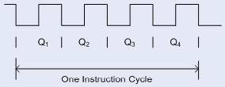
Clock And Instruction Cycles
42
Clock from the oscillator enters a microcontroller via OSC1 pin where internal circuit of a microcontroller divides the clock into four even clocks Q1, Q2, Q3 and Q4 which do not overlap.
These four clocks make up one instruction cycle (also called machine cycle) during which one instruction is executed.

Slide 45
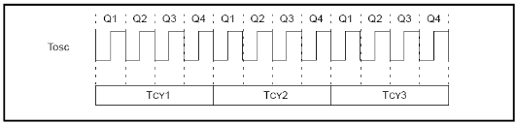
Execution of instruction starts by calling an instruction that is next in string.
Instruction is called from program memory on every Q1 and is written in Instruction Register (IR) on Q4.
Decoding and execution of instruction are done between the next Q1 and Q4 cycles. The following diagram shows the relationship between instruction cycle and clock of the oscillator (OSC1) as well as that of internal clocks Q1 – Q4.
Program Counter (PC) holds information about the address of the next instruction.
43

Slide 46
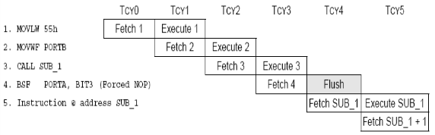
Pipelining in PIC
44
There are 35 single word instructions. A two-stage pipeline overlaps fetch and execution of instructions. As a result, all instructions execute in a single cycle except for program branches. These take two cycles since the fetch instruction is “flushed” from the pipeline while the new instruction is being fetched and then executed.
A typical picture of the pipeline is shown in Figure 3.
Figure3: Instruction Pipeline Flow

Slide 47
SUMMARY 1
• The microcontroller contains a processor, memory and input/output
devices
• The program is stored in ROM memory in numbered locations (addresses)
• The P16F877 stores a maximum of 8k 14 instructions in flash ROM
• The P16FXXX family uses only 35 instructions
• The P16F877 has 368 bytes of RAM and 5 ports (33 I/O pins)
• The ports act as buffers between the MCU and external systems
• The program is executed in sequence, unless there is a jump instruction
• The program counter tracks the current instruction address

Slide 48
ASSESSMENT 1
1 State the three main elements in any microprocessor system. (3)
2 State the difference between a microprocessor and microcontroller. (3)
3 Describe briefly the process of fetching an instruction. (3)
4 State the advantages of flash ROM, compared with other memory types. (3)
5 Explain why serial data communication is generally slower than parallel. (3)
6 State why Ports A and E in the PIC 16F877 cannot be used for digital input without initialisation. (3)
7 How many bits does the 8k MCU program memory contain? (3)

